Slide 1

Cybersecurity Workshop Password Attacks & Defense
Hands-On Edition
Learn • Practice • Secure

Slide 2
Workshop Goals & Outcomes
By the end of this workshop, you will:
Understand password attack mechanics
Identify password vulnerabilities
Implement strong password strategies
Use password managers effectively
Set up two-factor authentication
Defend against social engineering
Apply practical cybersecurity skills
2

Slide 3
Workshop Structure & Timeline
SECTION 1: Foundation (35-40 min)
Password basics and fundamentals
Attack vectors overview
SECTION 2: Attack Types (50-60 min)
Live demonstrations
Interactive exercises
SECTION 3: Defense Practices (40-50 min)
Password manager
Security audit
SECTION 4: Advanced Security (20-30 min)
Two-factor authentication
Resources and next steps
3

Slide 4
Password Authentication Fundamentals
What Are Passwords?
Primary digital identity verification method
Shared secrets between users and systems
First line of defense for accounts
How Password Storage Works:
Systems store password HASHES, not passwords
Hashing = one-way mathematical transformation
Same password = same hash
Why Passwords Are Targeted:
Gateway to personal and financial data
Often reused across multiple accounts
Predictable human password patterns
4

Slide 5

Password Attack Methods

Slide 6

Kali Linux Common commands
sudo – Run a command as a superuser (administrator privileges).
nano – Text editor or can create files.
cat – Display the content of a file directly in the terminal.
cd / cd.. – cd to go into a folder, and cd.. to go back to the previous folder.
ls – List files and directories in the current folder.
pwd – Show the full path of the current working directory.
unzip - Extract files from a ZIP folder.

Slide 7
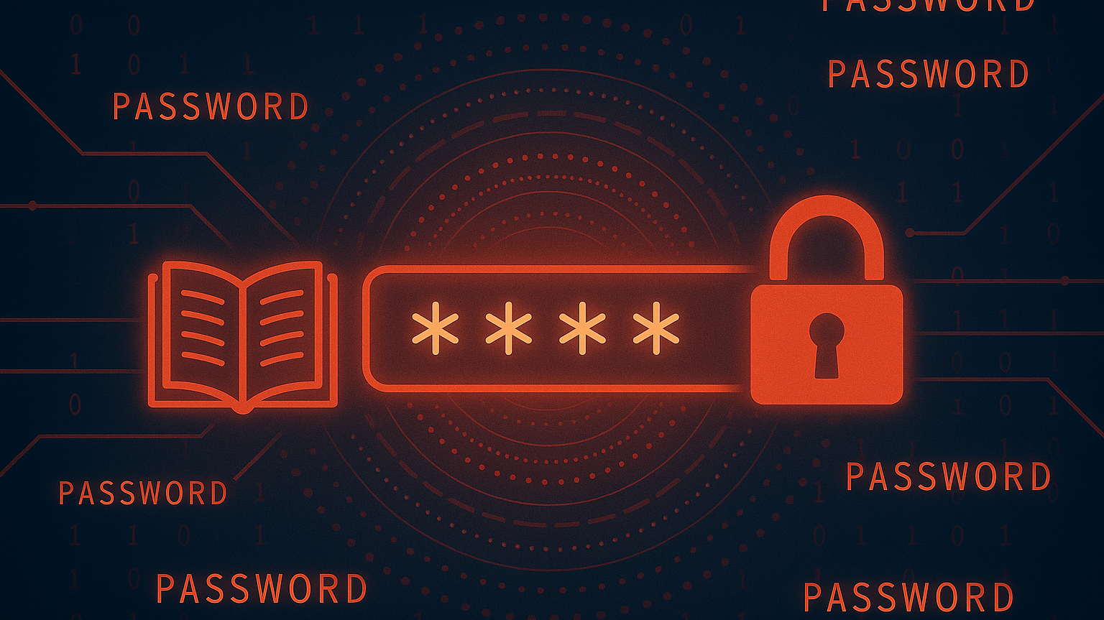
Dictionary Attacks
Dictionary Attack Strategy:
Uses precompiled common password lists
Includes leaked breach passwords
Tests common character substitutions
Much faster than brute force for weak passwords
Common Sources:
Top 10,000 most used passwords
Dictionary words in multiple languages
Keyboard patterns (qwerty, 123456)
Personal information patterns
Example Weak Passwords:
'password123' - Common word + number
'P@ssw0rd!' - Simple substitutions
Defense: Avoid dictionary words entirely

Slide 8

What is John the Ripper?
A powerful password-cracking tool used by security professionals.
Helps find weak passwords by trying to crack them using different techniques.
Supports dictionary attacks, brute-force attacks, and hybrid attacks.
Commonly used to crack password-protected ZIP files, hashes, and user accounts.
Popular in penetration testing and cybersecurity training.

Slide 9
Burp Suite
OSINT
Definition: Web vulnerability scanner & penetration testing tool
Uses: Intercept HTTP/HTTPS traffic, test web security, find vulnerabilities
Features: Proxy, Repeater, Intruder, Scanner
Common Users: Penetration testers, security researchers
Definition: Gathering publicly available information from open sources
Sources: Social media, public records, websites, news, forums
Uses: Reconnaissance, threat intelligence, investigations
Tools: Maltego, theHarvester, Google Dorking

Slide 10
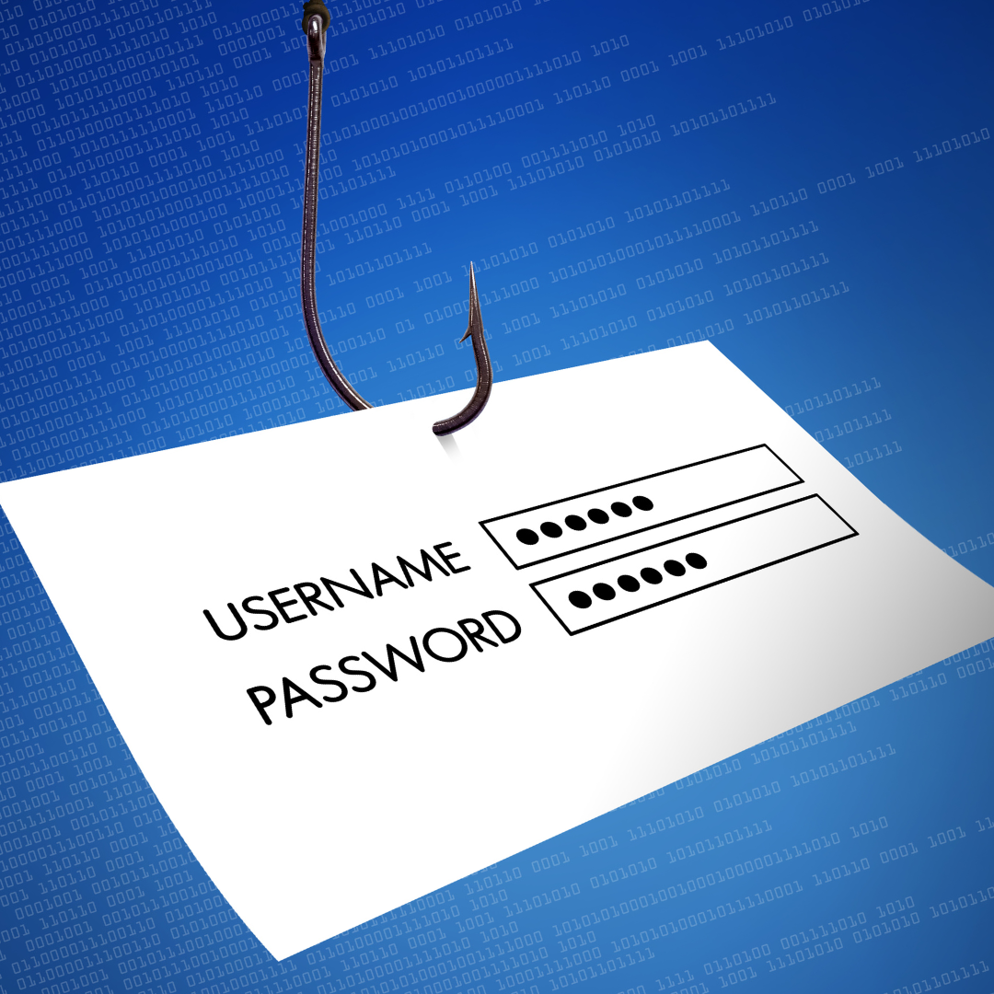
Phishing: Digital Deception
Phishing Mechanics:
Fake websites mimic legitimate services
Deceptive emails, texts, messages
Tricks users into voluntary credential entry
Creates false urgency or fear
Common Techniques:
Fake bank security alerts
Account verification requests
Prize notifications requiring login
IT department impersonation
Red Flags:
Urgent threatening language
Generic greetings
Suspicious URLs
Requests for sensitive information
Defense: Verify independently, don't click links

Slide 11

Brute Force Attacks
How Brute Force Works:
Tests every possible character combination
Starts with short passwords, increases length
Automated with specialized software
Time to Crack Examples:
4-digit PIN: Seconds
6-character password: Hours
8-character complex: Days to months
12-character passphrase: Centuries
Defenses:
Use 12+ character passwords
Enable account lockouts
Implement rate limiting
Use CAPTCHA systems

Slide 12
Credential Stuffing Attacks
What Is Credential Stuffing?
Uses breach username/password pairs
Automated testing across websites
Exploits password reuse habits
0.1-2% success rates = thousands of compromises
The Breach Ecosystem:
Major breaches expose billions of credentials
Credentials sold on dark web
Automated tools make attacks scalable
Real Impact:
LinkedIn breach ? Banking compromises
Gaming breach ? Email takeovers
Critical Defense:
Never reuse passwords
Monitor breach notifications
8

Slide 13
Password Hygiene Principles
Core Principles:
LENGTH OVER COMPLEXITY:
12+ characters minimum
Passphrases > complex short passwords
'coffee-mountain-dancing' > 'P@ss1!'
UNIQUENESS IS CRITICAL:
Every account needs unique password
No theme variations across accounts
Prevents cascade failures
AVOID PREDICTABLE PATTERNS:
No personal information
No keyboard patterns
No simple substitutions
REGULAR MAINTENANCE:
Change after breaches
Update critical accounts periodically
11

Slide 14

Defense Practices

Slide 15

Password Managers: Security Command Center
Why Password Managers:
Generate cryptographically random passwords
Store passwords in encrypted vault
Enable unique passwords for every account
Autofill prevents keylogger attacks
Sync securely across devices
Popular Options:
Bitwarden - Open source, free tier
1Password - Premium features
KeePassXC - Offline control
Dashlane - User-friendly
LAB ACTIVITIES:
1. Install password manager
2. Create strong master password
3. Import existing passwords
4. Generate new strong passwords
5. Practice autofill features
12

Slide 16
Two-Factor Authentication (2FA)
2FA Fundamentals:
Something you KNOW + Something you HAVE
Password + Phone/App
Dramatically reduces compromise risk
Protects even with compromised passwords
2FA Methods:
SMS (Least Secure):
Convenient but vulnerable to SIM swapping
Authenticator Apps (Recommended):
Google Authenticator, Authy, Microsoft
Time-based codes generated locally
Work offline, more secure
13

Slide 17
2FA Implementation Guide
PRIORITY ACCOUNTS:
1. Email (password reset gateway)
2. Financial institutions
3. Work/professional accounts
4. Social media with personal data
5. Cloud storage
SETUP PROCESS:
Go to account security settings
Select Two-Factor Authentication
Choose authenticator app over SMS
Scan QR code with app
Test with generated code
SAVE backup codes securely
BACKUP PLANNING:
Store codes in password manager
Consider backup authenticator
Update recovery options
14

Slide 18
Personal Security Audit
AUDIT CHECKLIST:
PASSWORD ANALYSIS:
List all online accounts
Identify reused passwords
Check against breach databases
Rate password strength
2FA STATUS:
Which accounts have 2FA enabled?
Which priority accounts lack 2FA?
What 2FA methods are used?
ACTION PLAN:
1. Immediate: Enable 2FA on email/banking
2. This week: Set up password manager
3. This month: Update weak passwords
4. Ongoing: Regular maintenance
EXERCISE: Complete audit worksheet
15

Slide 19
Resources & Next Steps
ESSENTIAL TOOLS:
PASSWORD MANAGERS:
Bitwarden: bitwarden.com
1Password: 1password.com
KeePassXC: keepassxc.org
BREACH MONITORING:
Have I Been Pwned: haveibeenpwned.com
Firefox Monitor: monitor.firefox.com
LEARNING:
SANS Awareness: sans.org
CISA Tips: cisa.gov/cybersecurity-tips
EFF Guide: eff.org/deeplinks
NEXT STEPS:
Implement action plan
Join security communities
Consider advanced training
16

Slide 20
Workshop Complete!
WHAT YOU LEARNED:
Password attack methods and defenses
Password hygiene best practices
Password manager usage
Two-factor authentication setup
Security audit techniques
CERTIFICATE:
Available upon request
Thank you for attending!
17

Slide 21


Slide 22
